Slide 1


Operation Analytics and Investigating Metric Spike trainity Project #3
By:
ANURAG CHANGMAI Data Analytics Trainee 27/06/2023

Slide 2
Project Description
Operation analytics is crucial for any organization that is aiming for success in its field. It not only helps the organization analyze its end-to-end operations but also aids in identifying the areas where it could further improve upon.
It also has the added benefit of bringing together different teams or units of the organization when trying to understand the operations. This creates a synergy in their operations, and consequently that of the organization itself.
In this project, I perform operation analytics for a hypothetical organization that intends to understand its user base. I also analyze the operations its users perform and understand engagement metrics over time.

Slide 3
Approach
This project starts by first obtaining a sample dataset of internal jobs performed for the benefit of the users, a dataset of the users themselves, along with their engagements on the organization’s platform.
This data is then cleaned and stored in a database called op_analytics, using multiple tables such as job_data, users, events, and email_events.
Once this is done, SQL queries are executed on these tables to obtain specific data as per requirements.

Slide 4
Tech-stack used
In the execution of this project, the following software was used:
1. Oracle MySQL Workbench 8.0 v8.0.33
→ It was used to run SQL queries to create the database, perform operations on the tables within the database, and obtain desired outputs.
2. Microsoft Excel 2019 v2305
→ It was used to understand the data which was in CSV format, clean it, and prepare it to be loaded into SQL database.

Slide 5
Insights
In the following slides, insights on these points are explained:
From a user-benefit perspective, insights from internal data on translation jobs are obtained. This will be regarded as Case 1 in the upcoming slides.
From a user perspective, insights on user engagement, user growth, weekly user retention, weekly device-wise user engagement, and user email engagement are obtained. This will be regarded as Case 2 in the upcoming slides.

Slide 6
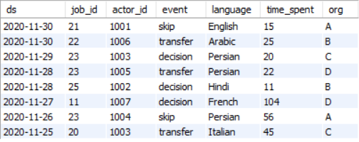
Case 1
This case makes use of data from the table shown below, which appears to deal with translation features provided on the organization’s website.

Slide 7
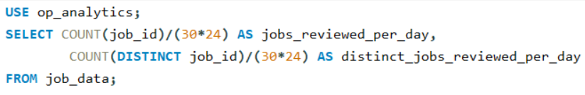
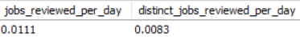
Case 1: Number of jobs reviewed over time
SQL QUERY
RESULTS
This shows that on average, 0.0111 jobs are reviewed per day. This average reduces to 0.0083 when we consider only the distinct jobs of the day.

Slide 8
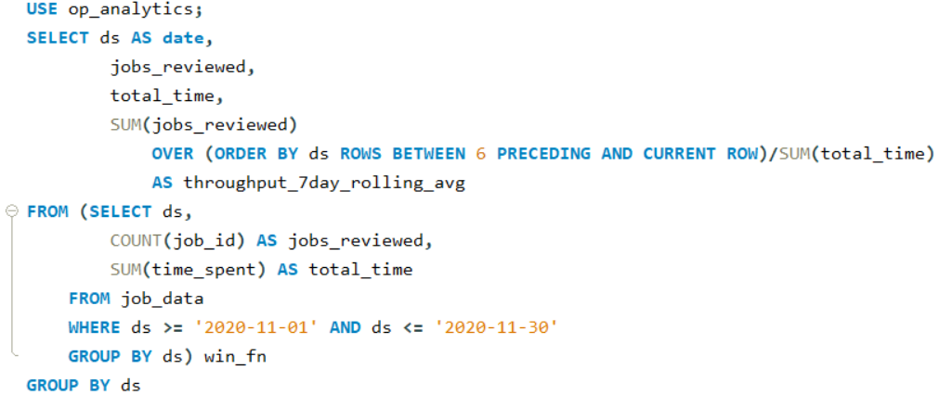
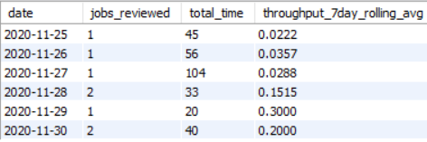
Case 1: Throughput as a 7-day rolling average of all jobs performed
SQL QUERY
RESULTS
This shows that the throughput varies every day with the maximum being 0.3 and the minimum being 0.0222. To come to this conclusion, we chose a 7-day rolling average instead of a daily metric as it provides finer details for the 6 days in question.

Slide 9
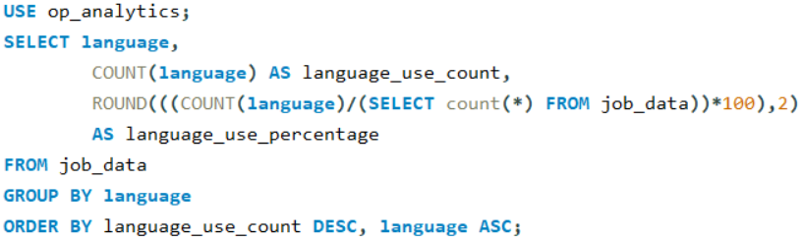
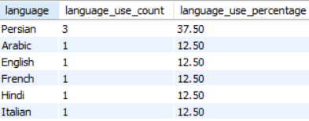
Case 1: Percentage share of each language
SQL QUERY
RESULTS
This shows that Persian occupies the major share of activities @ 37.5%. The remaining languages (Arabic, English, French, Hindi, and Italian) share the remainder at 12.5% each.

Slide 10
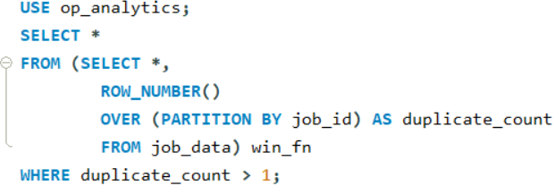
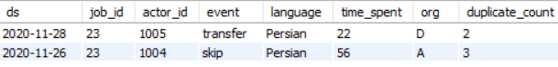
Case 1: Identifying duplicate rows, if any
SQL QUERY
RESULTS
This shows that there are 2 rows which are duplicated on the basis of their job_ids. The duplicate_count column is used to enumerate the duplicate instances as rows.

Slide 11
Case 2: ER Diagram
users
user_id
created_at
events
user_id
event_type
email_events
user_id
occurred_at
company_id
language
activated_at
state
occurred_at
event_name
location
device
user_type
action
user_type

Slide 12
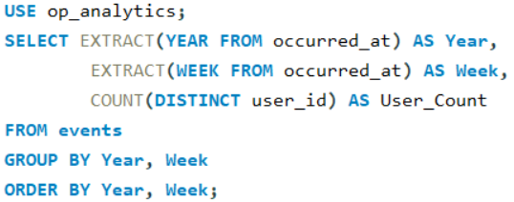
Case 2: Weekly User Engagement
SQL QUERY

Slide 13
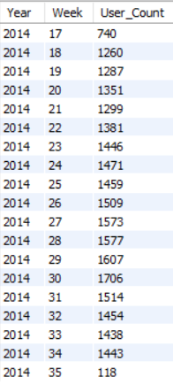
Case 2: Weekly User Engagement (Cont.)
RESULTS
This shows the user count from weeks 17 to 35 in the year 2014.
Weeks 17-18 saw a major increase of 520 users while weeks 34-35 saw a major decrease of 1325 users.

Slide 14
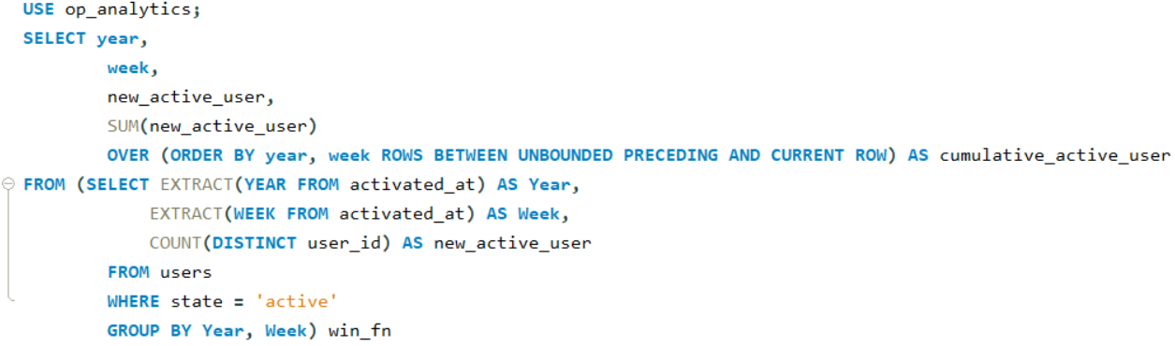
Case 2: Weekly User Growth
SQL QUERY

Slide 15
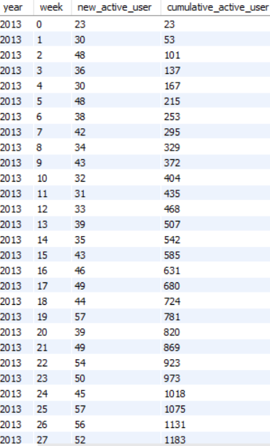
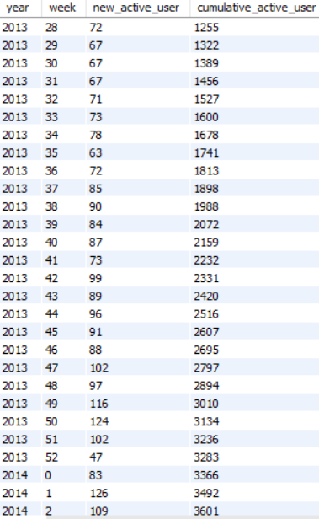
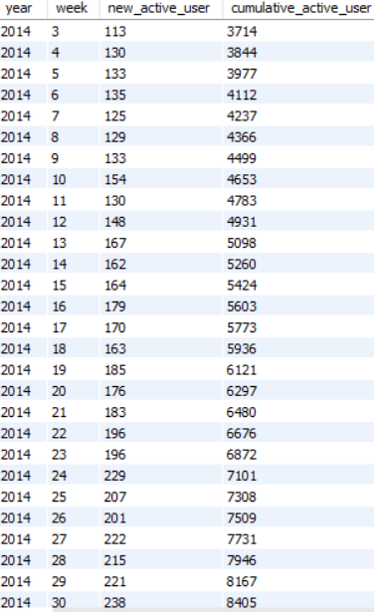
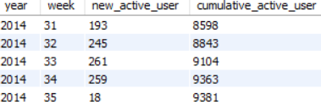
Case 2: Weekly User Growth (Cont.)
RESULTS
This shows the weekly user growth from the 1st week of 2013 to the 35th week of 2014. The 33rd week of 2014 saw the highest number of new active users @ 261, and the 35th week of 2014 saw the lowest number of new active users @ 18.

Slide 16
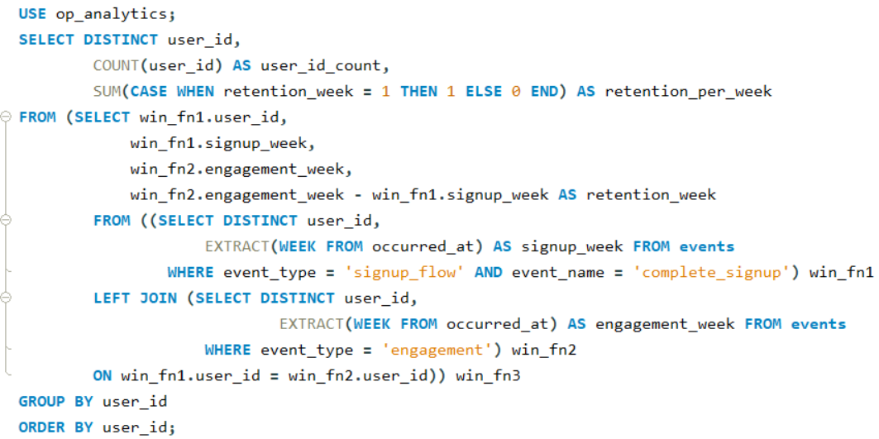
Case 2: Weekly User Retention
SQL QUERY

Slide 17
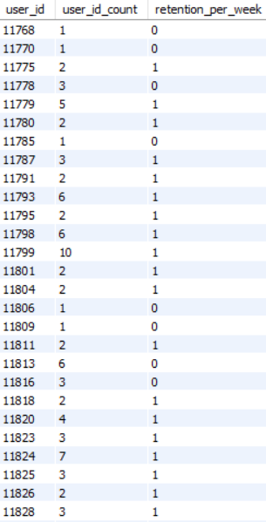
Case 2: Weekly User Retention (Cont.)
RESULTS
This shows the count of retained users and the number of weeks for which they were retained. Since this data pertains to all the users in the database, only a small section of the data is reproduced here. The entire data can be found in:

Slide 18
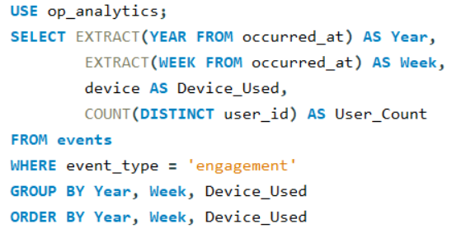
Case 2: Weekly Device-wise User Engagement
SQL QUERY

Slide 19
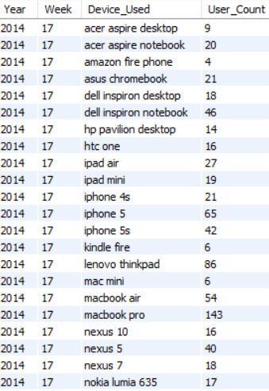
Case 2: Weekly Device-wise User Engagement (cont.)
RESULTS
This shows the number of users who have accessed the organization’s platform from various devices over the weeks in 2014. Once again, only a small section of the data is reproduced here, with the entire dataset available in:

Slide 20
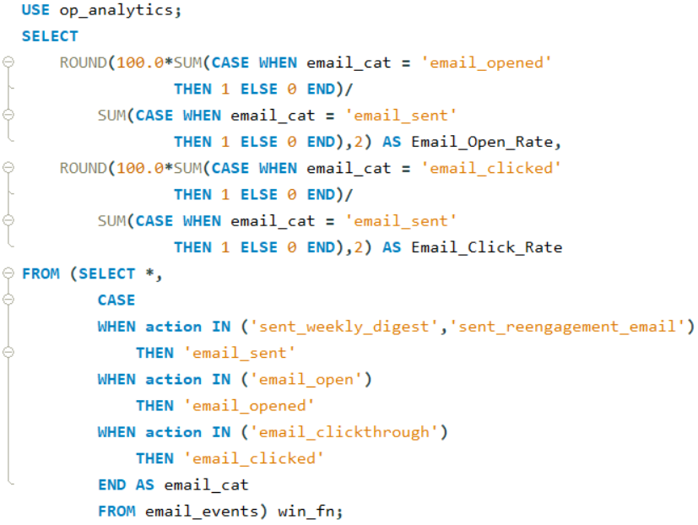
Case 2: User Email Engagement
SQL QUERY

Slide 21
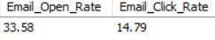
Case 2: User Email Engagement (Cont.)
RESULTS
This shows that 33.58% of all emails sent are opened by the users. However, only 14.79% of all emails sent receive an action (click) from the users.

Slide 22
Result
Based on the insights provided here, internal work practices can be ramped up should they be required to provide better services to users.
Moreover, the various teams of the organization can work together to implement steps for variable user interaction and retention. They can also focus on user experience on different devices to ensure uniform service is provided, irrespective of device format.
Concurrently, email marketing teams could implement various improvements to ensure higher email open and click rates. Campaigns could be run in these mailers that could aid in increased user retention and interaction, as well as new user creation.
This project has been very helpful in understanding advanced SQL concepts and provided insights into how an operations team performs in an organization and helps in its growth.

